Slide 1
Managing the data science team
Jeff Leek
@jtleek
www.jtleek.com

Slide 2
Individual meetings
Regular
Updates, problems, and goals

Slide 3

http://www.informationweek.com/big-data/big-data-analytics/5-ways-data-science-teams-can-raise-their-profiles/a/d-id/1316532

Slide 4
Data science team meetings
Regular
Updates, problems, and goals
Peer review
Team priorities and motivation

Slide 5
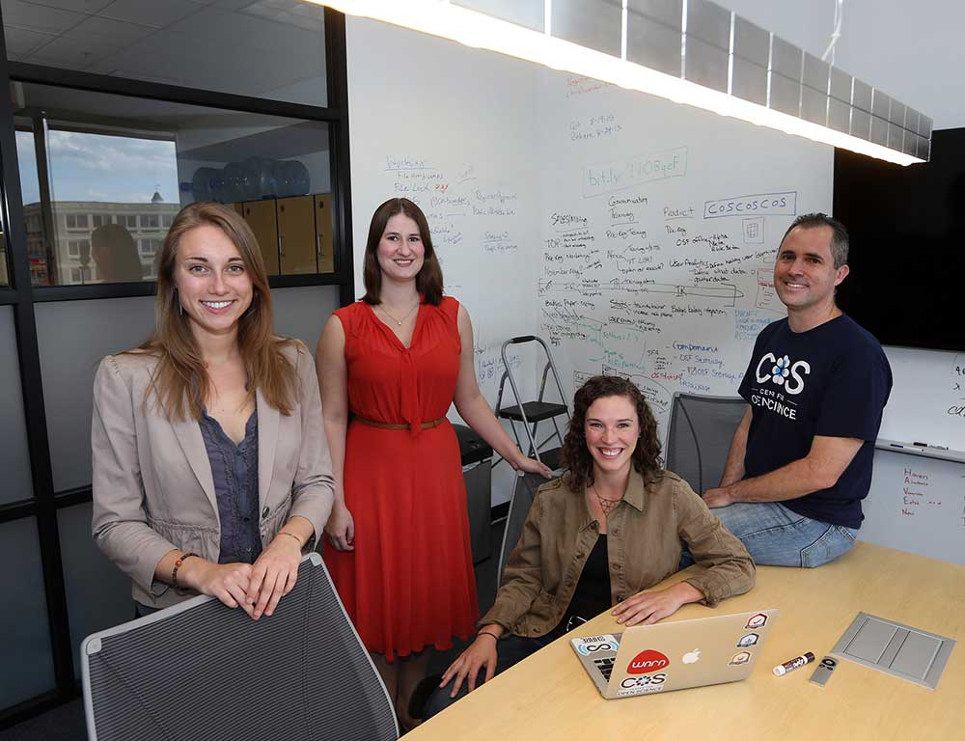
http://www.pulseheadlines.com/psychology-studies-reliable/4258/

Slide 6
Monitoring interactions
Actively
Passively

Slide 7

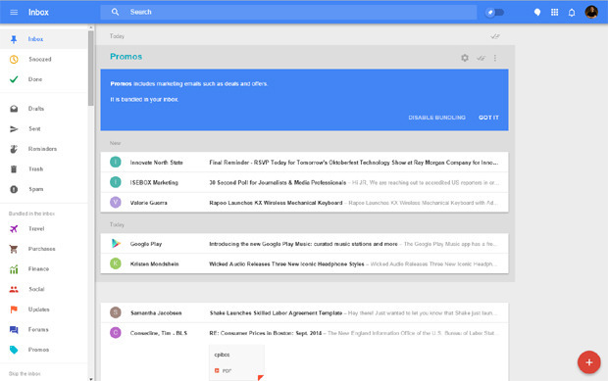
Active management
Passive management

Slide 8
Keeping things running
Open door policy
Quick questions via chat/email

Slide 9
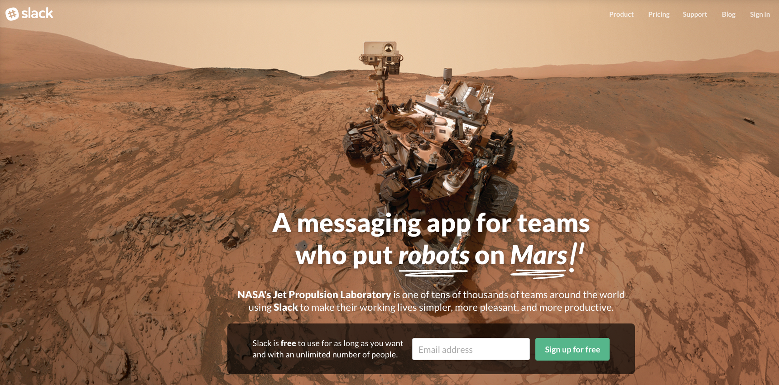
https://slack.com/

Slide 10
Managing growth
Introduction to new tools
Introduction to new interactions
Opportunities for advancement

Slide 11
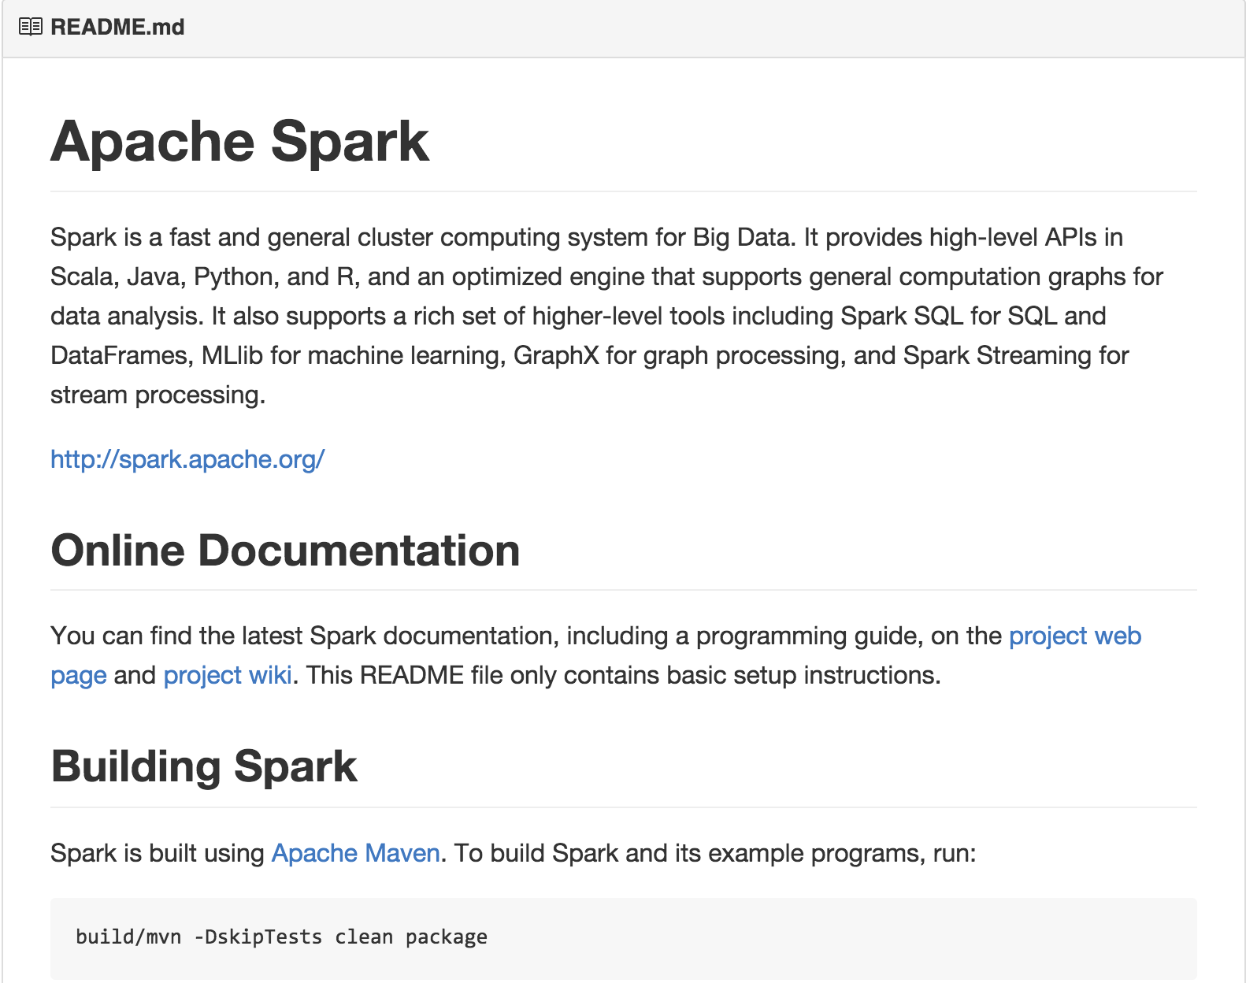
https://github.com/apache/spark

